Slide 1


AUTOMATIC ELECTRICITY BILL GENERATOR-CUM-TRACKER
PRAGYAN HARDWARE HACKATHON
BY TEAM CTRL-ALT-ELITE

Slide 2
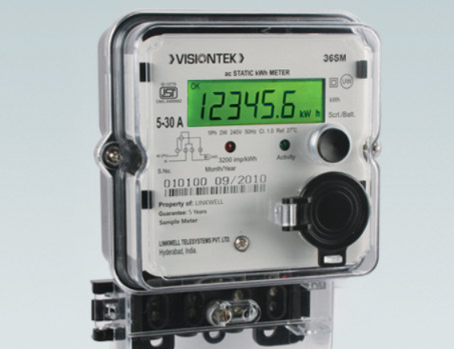
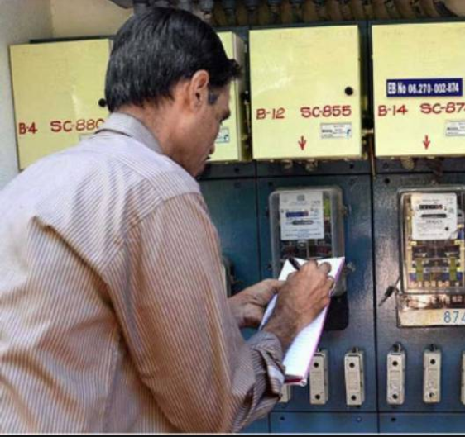
EXISTING SYSTEM
EB authoritative notes meter readings for bill calculation
This system is prone to human error
Unintentional
Intentional (corruption)

Slide 3

LIMITATIONS IN EXISTING SYSTEM
1. Delayed Reading
The delay leads to increased bill reading.

Slide 4
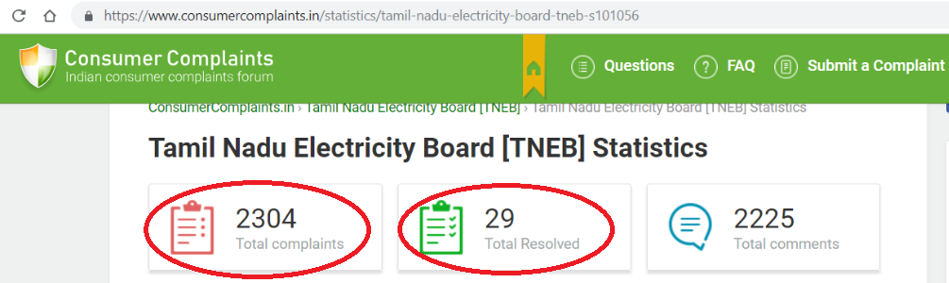
2. Human Errors
Many complains have been registered regarding the incorrectness of the bills.
The bills maybe incorrect due to reasons such as reading error, manipulation, etc.

Slide 5

IMPACT OF IMPLEMENTING THIS SYSTEM
After the implementation of this project there will be no need to employ large number of workers throughout our country who come to the house and take readings manually once in two months. Thus lot of money and time can be saved and it can be productively used by our government for implementing various schemes for the betterment of our country.

Slide 6
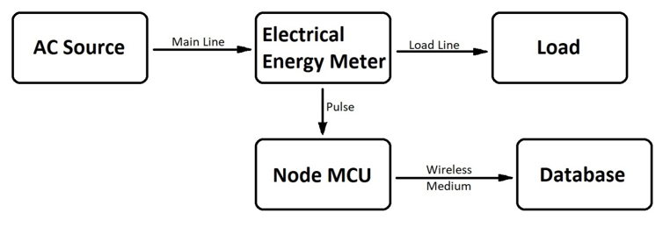
Block diagram

Slide 7
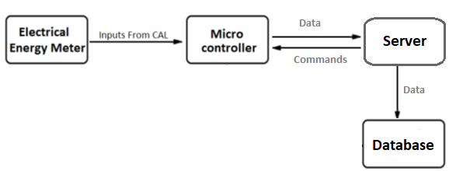
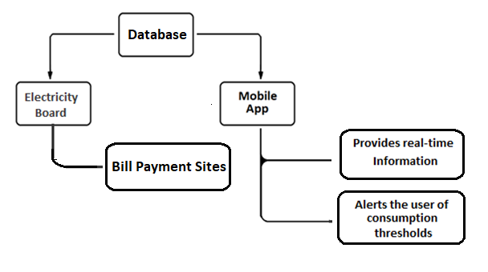

Slide 8
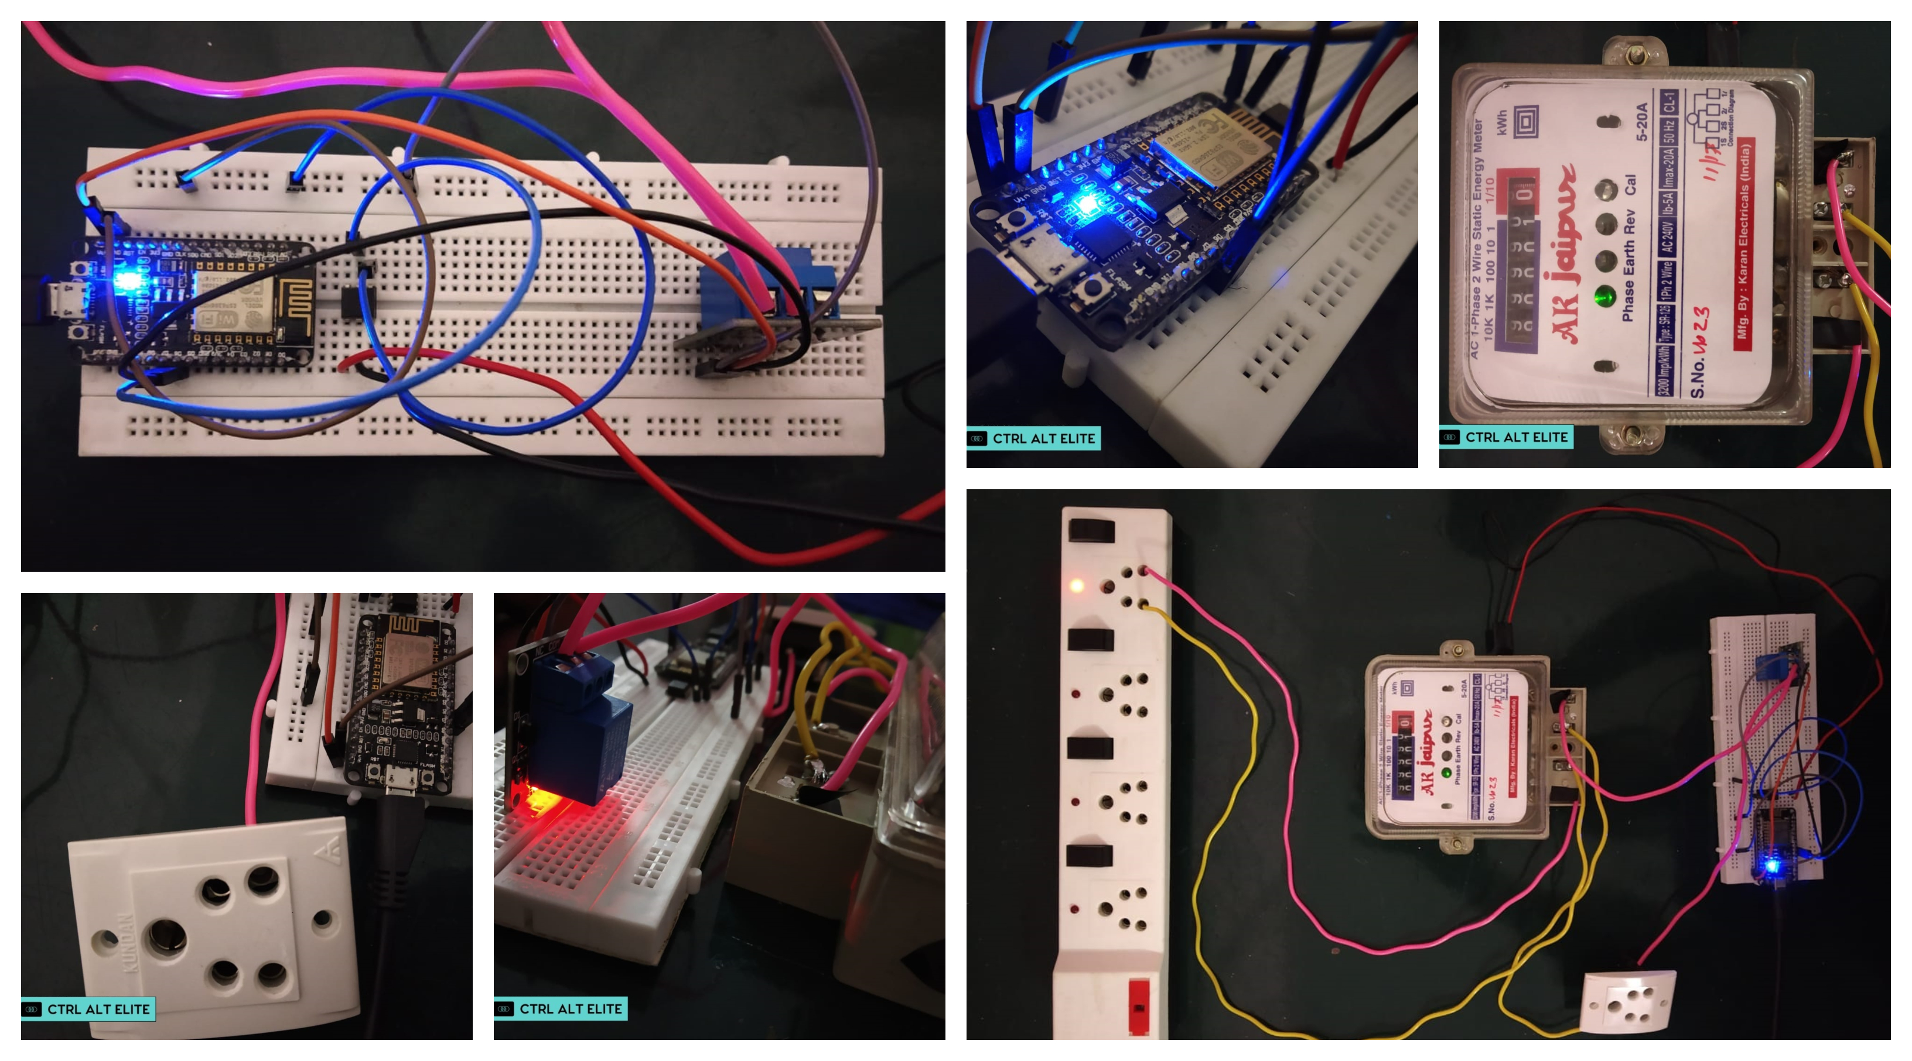
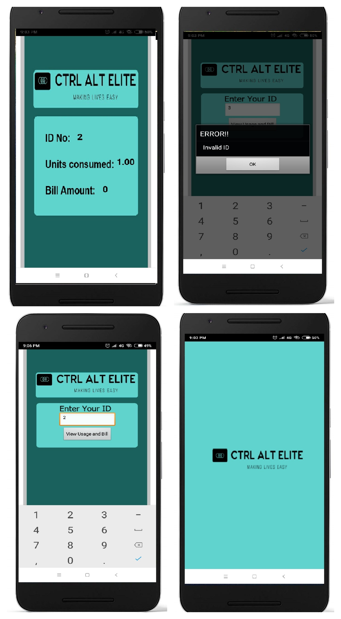

Slide 9
Why should we adopt this system? How is it different from the conventional system?

Slide 10
CALCULATING THE INITIAL COST
Though there is an initialization expenditure, the reduction in cost of processing compensates for that.
Items | Price
Node MCU | 310
Opto coupler(4n35) | 15
Relay | 80
total | 405

Slide 11
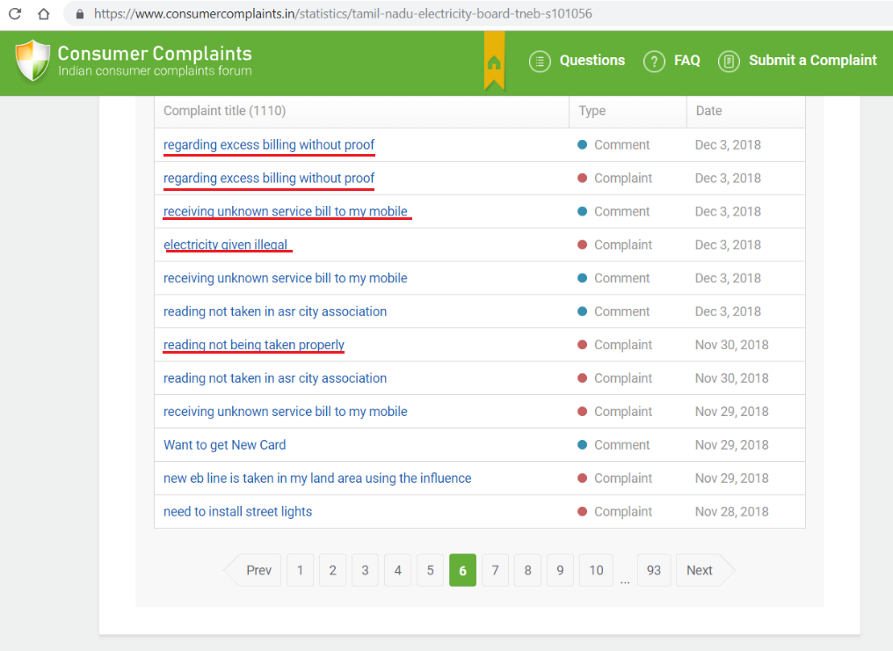
Corruption resistant
This system eliminates some of the commonly known errors and other methods of corruption .

Slide 12
Intimates customer
Regularly informs the customer about the amount of electricity used since the last reading which will help the customer limit usage and save money.
Unit | Amount / Unit | Service Charge
0-100 | Free | -
101-200 | ₹ 2.50 | ₹ 30
201-500 | ₹ 3.00 | ₹ 30
101-200 (Above 500 Units) | ₹ 3.50 | ₹ 40
201-500 (Above 500 Units) | ₹ 4.60 | ₹ 50
Above 500 | ₹ 6.60 | ₹ 50

Slide 13
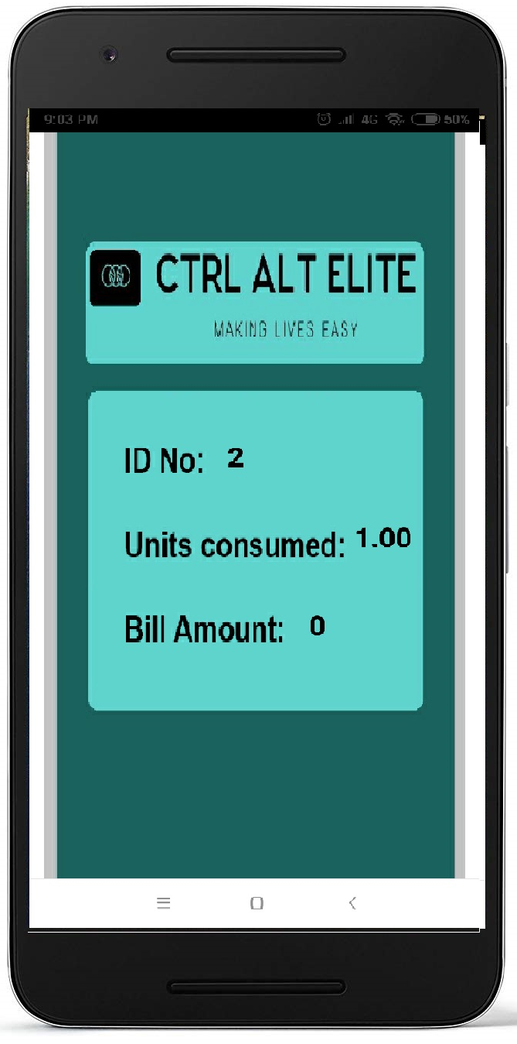
Mobile application
This mobile app carries out duties such as intimating the user.
Keeps the user updated continuously regarding consumption.
When does it intimate the user?
Since the electricity bill rate drastically changes at 100,200 and 500 units, Intimating the user at 90, 180, 470 units respectively helps user to limit the usage and save money.

Slide 14

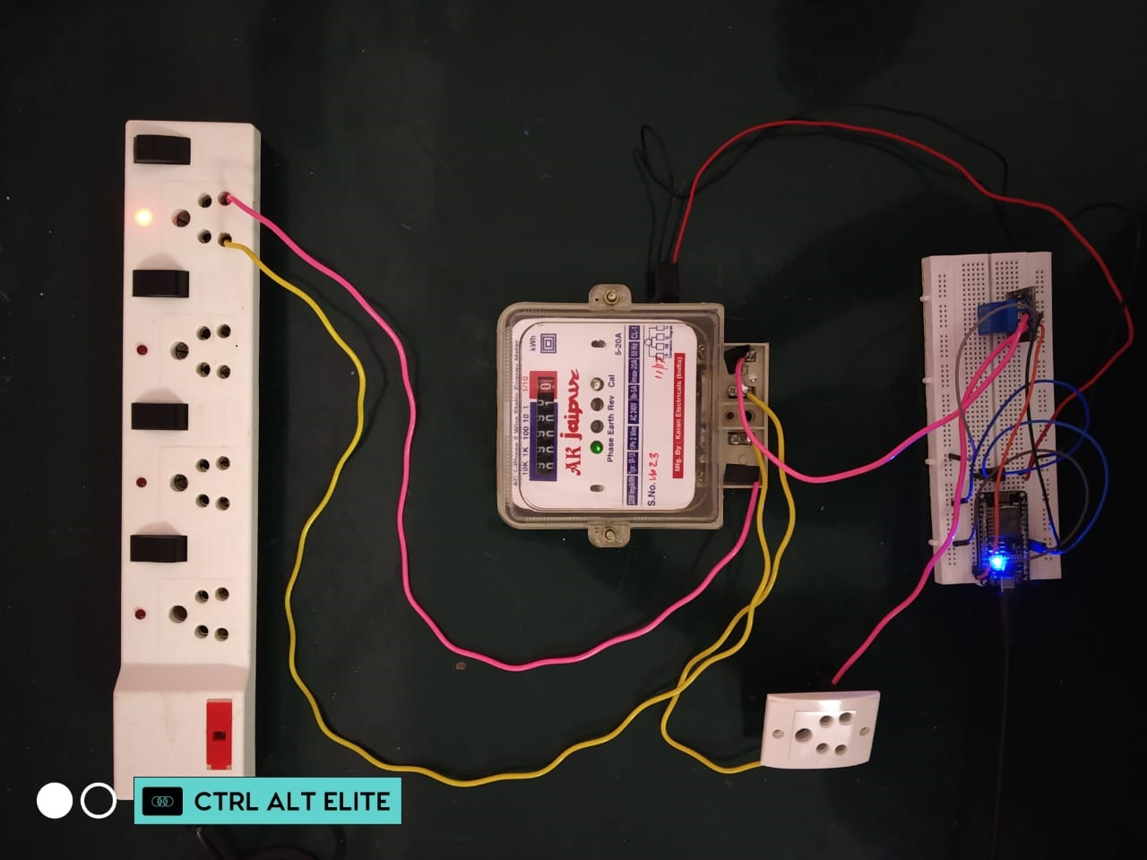
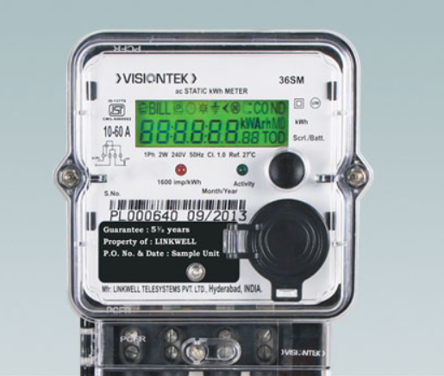
JUST
There is no need for replacing the meter.
The module needs to be attached.

Slide 15
Resources
Statistics:
https://www.consumercomplaints.in/statistics/tamil-nadu-electricity-board-tneb-s101056
TNEB Working mechanism:
http://tneb.tnebnet.org/tariff_new.html
https://en.wikipedia.org/wiki/TNEB
Flaws of current EB systems:
https://circuitdigest.com/tech-articles
Other info and media: Google

Slide 16
THANK YOU
CTRL-ALT-ELITE
SUDHARSAN S
BARATH KUMAR S
NITHIN EISWAR V
ABHISHEK L
ARVINTH S
S P SHARAN
B.Tech 1st year , ECE Department , NIT Trichy.

